Slide 1
CONTROL OF AUTONOMOUS FLIGHT OF A QUADCOPTER
USING CRIUS ALL-IN-ONE PRO V2
Department of Electrical and Computer Engineering
University of North Carolina at Charlotte
Presented by: Mayuka Srinivasan
April 29th ,2014
Advisor : Dr. James Conrad
<number>/16

Slide 2
Overview
Introduction
Motivation
Implementation
  Building the frame
  Setting up software for Manual Flight
  Programming the Transmitter
  Remote monitoring with Mission Planner using X-BEE’s
  Autonomous Flight of Quadcopter
  Wii- camera Hacking and Interface
  Build an IR beacon
Results
Conclusion
<number>/16

Slide 3
Introduction
Quad copters commonly known as drones, is an aerial vehicle whose flight is controlled with the help of a remote control on the ground or autonomously.
These vehicles have a wide variety of real-world applications, which include:
    Military application
    Scientific research
    Civilian causalities
    Archaeology
    Forest fire detection and many more
Most of these systems used indoors, rely on exteroceptive sensors for tracking and prior maps of the environment for navigation.
<number>/16

Slide 4
Motivation
Autonomous flight can be achieved by sending external control signals from a remote or on-board controller to the main controller
Using a Red Board causes a clash between the remote data and the data present in the controller.
Using arducopter code, autonomous flight can be achieved by replacing GPS signals with Sonar readings for indoor flight.
Tracking can be achieved by hacking the Wii-camera of a Nintendo Wii-remote controller and using them to determine IR beacons
<number>/16

Slide 5
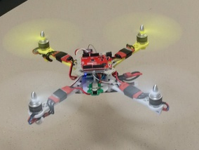
Building the Frame
The first step towards successful flight of a Quad copter is to build a suitable frame.
Components necessary to build a basic frame are:
  Brushless motors-2210
  Propellers
  Electronic Speed Controllers
  Cries Aiop-V2 board
  Power Distribution Board and
  Battery
Fig.1: ST-360 Basic Frame[12]

Slide 6
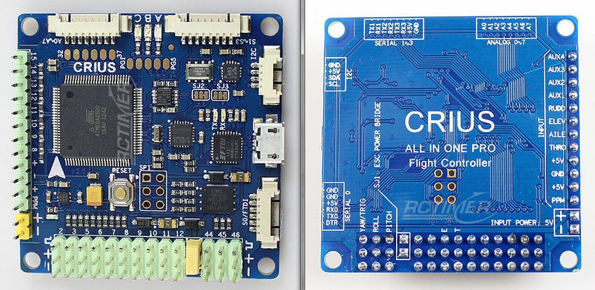
Crius All-in-One Pro V2
Fig.2: Crius AIOP – V2[4]

Slide 7
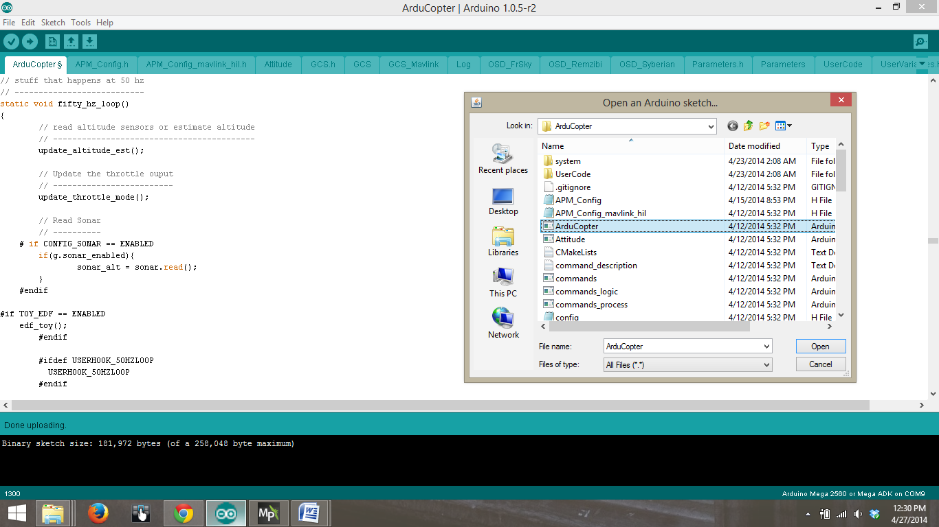
Setting up Software for Manual Flight
MegapirateNG: The arducopter code that is compatible with Crius board.
Arduino: This is used to load the Arducopter code make any required changes.
Fig.3: MegapirateNG code in Arduino

Slide 8
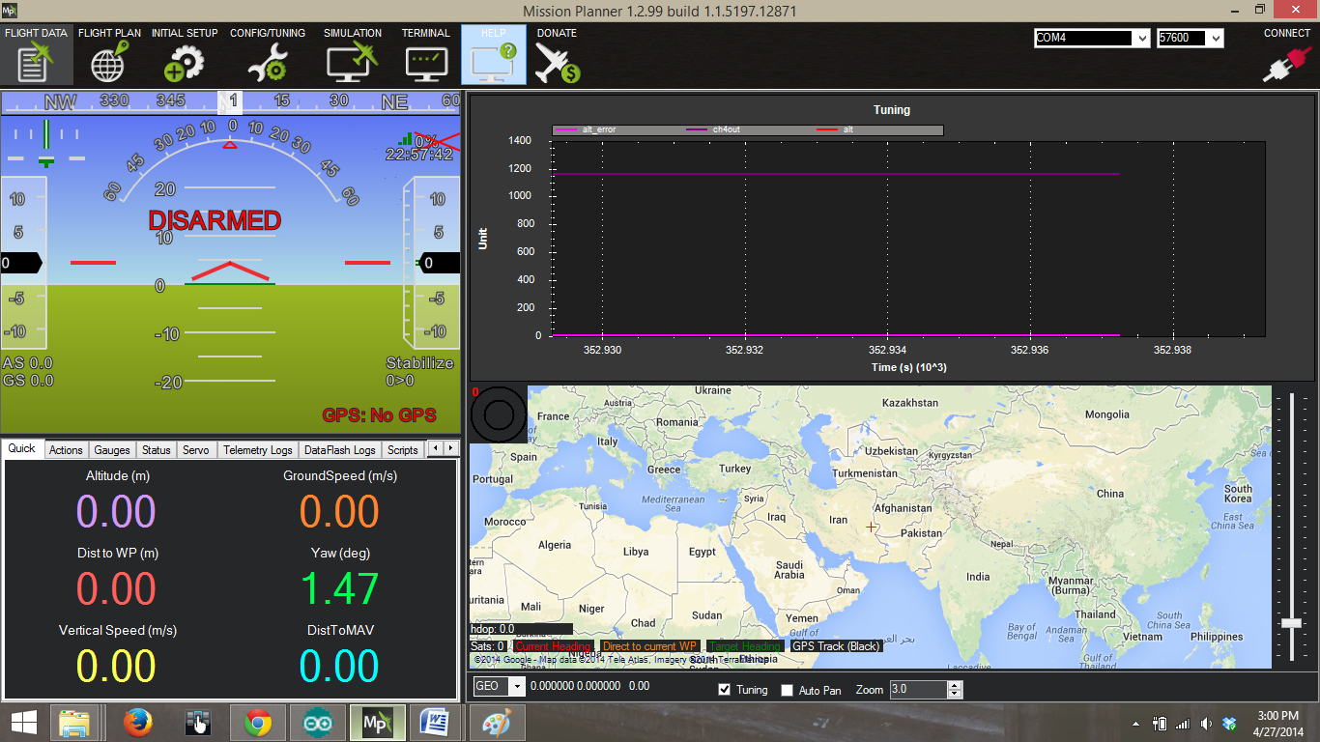
Setting up Software for Manual Flight
Mission Planner : A Simulator to monitor the behavior of the Quadcopter and act as a Graphical User Interface.
Fig.4: Mission Planner

Slide 9
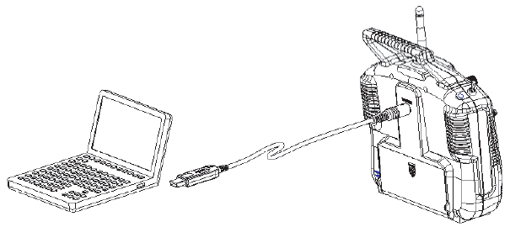

Programming the Transmitter
The Fly-Sky transmitter used in this project is user-programmable.
Install T6 config. software and install all drivers to establish a communication.
Change mode settings to and train the transmitter as required
Fig.5: Trainer the transmitter[11]
Fig.6: Transmitter communicating in the software [11]

Slide 10
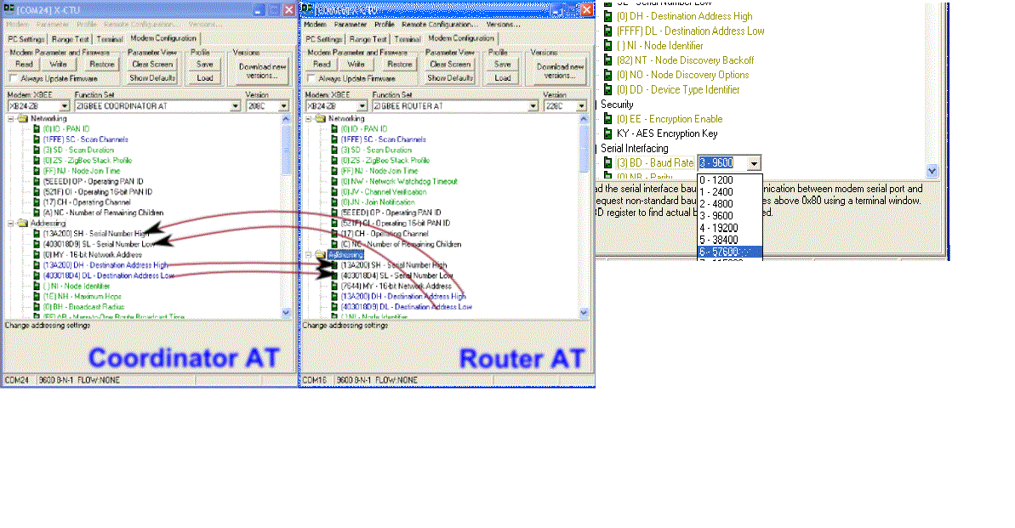
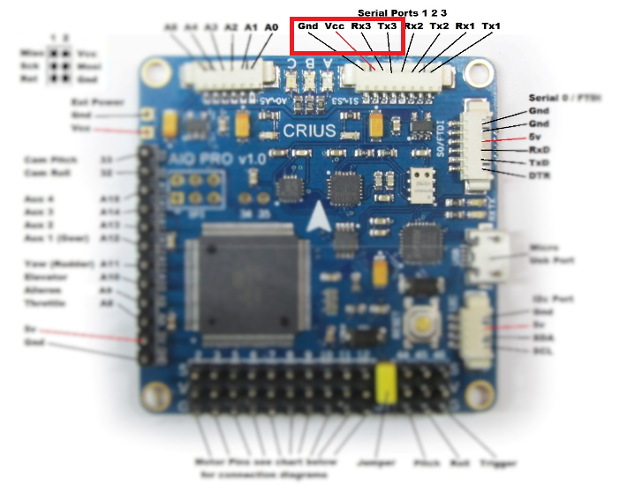
X-BEE communication
Using X-CTU software hardcode the destination addresses of the X-BEEs for continuous flow of data
Set the Baud rate to 56700 to establish unique communication frequency and avoid external disturbances between Mission Planner and the Quadcopter
Setup unique Pan-Id’s to avoid misinterpretation of data
Fig.7: Destination add., Pan Id and Baud rate setup on X-CTU[2]
Fig.8: X-BEE pins on Crius board
<number>/16

Slide 11
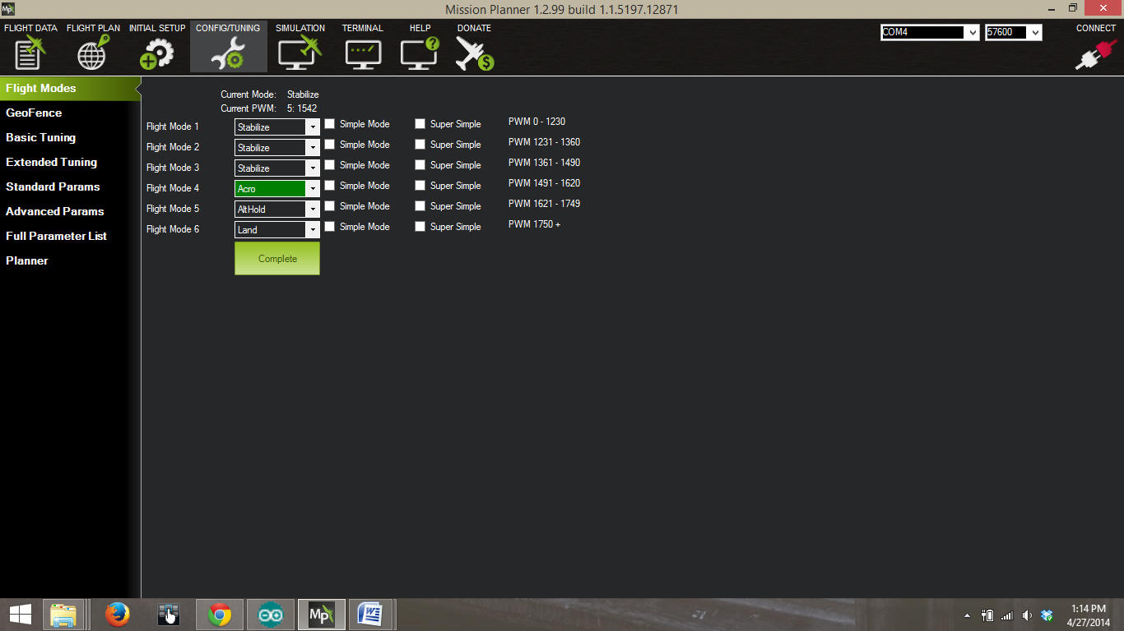
Autonomous Flight Control
Change the flight modes of using Mission Planner and test it functionality in the Manual Mode.
Make changes to the arducopter code once the manual flight is successful.
Fig.9: Changing Modes using Mission Planner
<number>/16

Slide 12
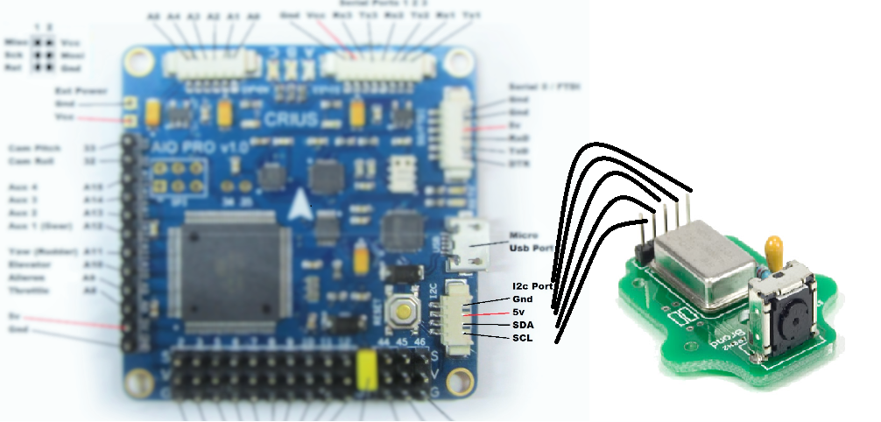
Wii- camera Hacking and Interface
Wii-camera needs to be de-soldered from the Ninendo Wii remote controller since it is not readily in the market.
Attach the camera to breakout board and connect it to the Crius board.
Fig.10: Wii-camera interface to Crius Board
<number>/16

Slide 13
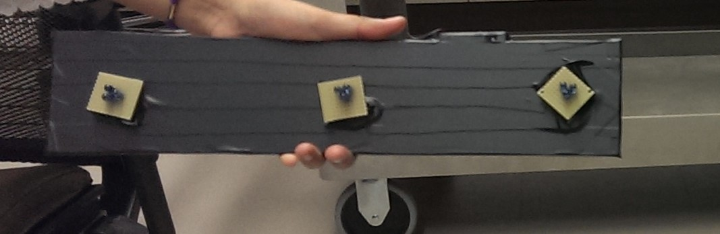
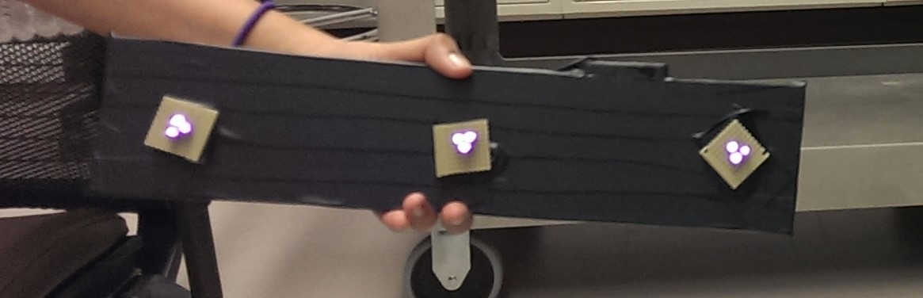
Build an IR beacon
  An IR beacon is a set of IR LEDs connected in series and can be switch ON and OFF using a switch, powered with the help of a couple of AA batteries.
  This IR beacon can be used by the Wii-camera to detect the blobs and track them using a Quadcopter.
Fig.11: When the LEDs are OFF
Fig.12: When the LEDs are ON
<number>/16

Slide 14
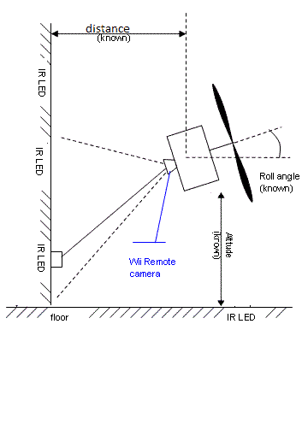
Working
When the camera is interfaced with the Quadcopter and on detection of an IR beacon it stays in flight and holds the given altitude.
When the beacon is not detected, the Quadcopter lands
Fig.13: Pictorial representation of the camera detecting the beacon
<number>/16

Slide 15
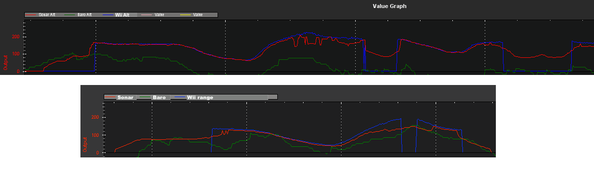
Results
Fig.14: Graphical Plots of Wii-camera detecting the blobs on Mission Planner
The outputs of the camera is checked using the Mission Planner and the outputs clearly show that the blue graphs changes in the presence and absence of IR blobs

Slide 16
Conclusion
The arducopter code supports adding user written code in the USER HOOKS loop and since arducopter is controlled by loops that occur at different speeds, most functions just update values while a few functions actually control the Quadcopter.
The results of this project clearly indicate that the arducopter code can be edited to control the Quadcopter and attain an autonomous flight without the use of a GPS in an indoor environment.
<number>/16

Slide 17
Reference
[1] http://the-force-physics.com/index.php?title=User_Hooks_and_Adding_User_Flight_Modes
[2] http://multi-science.metapress.com/content/80586kml376k2711/
[3] http://letsmakerobots.com/content/wii-ir-camera-standalone-sensor
[4] http://dev.ardupilot.com/
[5] http://copter.ardupilot.com/wiki/tuning/
[6]http://diydrones.com/forum/topics/arducopter-navigation-with-wii-camera?id=705844%3ATopic%3A649954&page=1#comments
[7]http://diydrones.com/forum/topics/arducopter-navigation-with-wii-camera?commentId=705844%3AComment%3A662476
[8] http://wiibrew.org/wiki/Wiimote#IR_Camera
[9] http://johnnylee.net/projects/wii/
[10] http://www.instructables.com/id/Wii-Remote-IR-Camera-Hack/?lang=de
[11] http://helihelp.rabbitsvc.com/
[12] HOW-TO-GUIDE.pdf by Cory Engel and research material on Wii-camera interface to arudino and vision system for miniature Quadcopters by Audrow.J Nash.

Slide 18
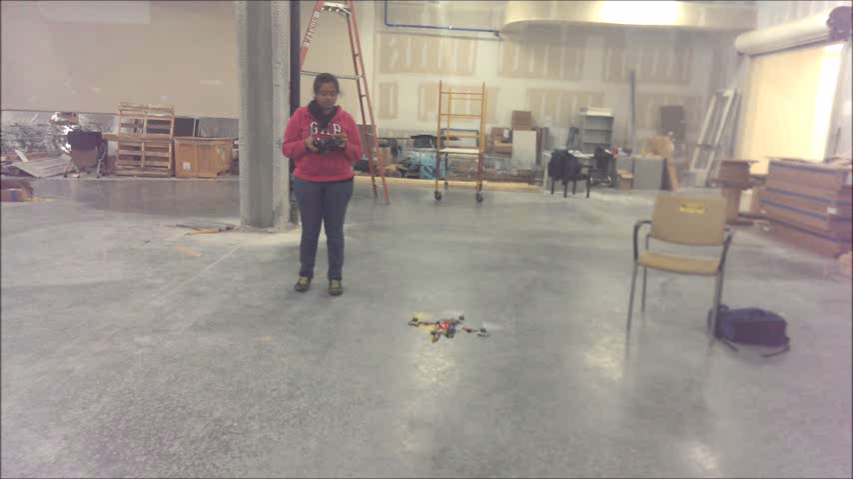
Demo Video
https://www.youtube.com/watch?v=5fkkof-xFr8&feature=youtu.be

